Slide 1
Revision of McManus’ 1985 Handedness Model

Slide 2
What is McManus’ 1985 Handedness Model?
In 1985, I. C. McManus proposed a genetic model for the determination of handedness in humans.
One gene with two alleles: D (dextrality) and C (chance)

Slide 3
What is McManus’ 1985 Handedness Model
The model assumes:
The genes control the phenotypes of twins similarly to the way they control the phenotypes of singletons.
Each individual is either left-handed or right-handed.
Same true rate of left- handedness across all studies and generations, difference in the observed rate of left-handedness is due to fluctuations in the criteria used to determine the handedness.
Uniform allele frequencies between studies.
Notes:
1. בניגוד למודל של אנט

Slide 4
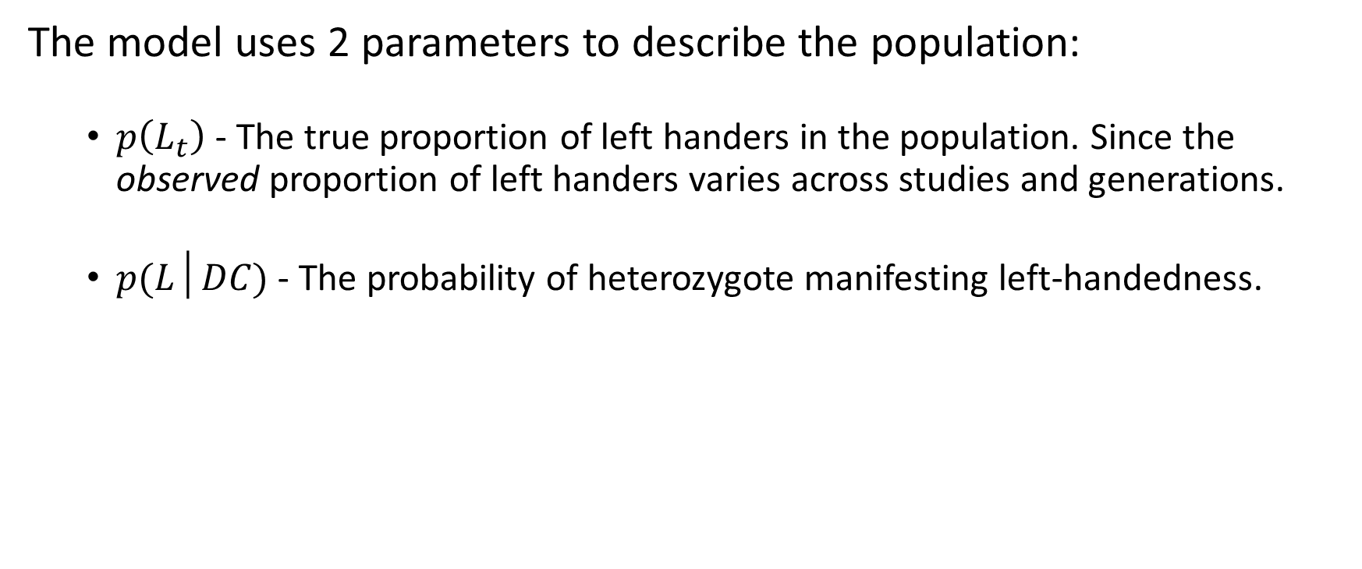
What is McManus’ 1985 Handedness Model
The model uses 2 parameters to describe the population:
$p\left(L_{t}\right)$ - The true proportion of left handers in the population. Since the observed proportion of left handers varies across studies and generations.
$p(L│DC)$ - The probability of heterozygote manifesting left-handedness.

Slide 5
Method

Slide 6
The Data
To estimate the model parameters 3 types of datasets were used:
Triplets datasets: One offspring and his parents.
Multi- offspring datasets: siblings and their parents.
Twins datasets: twin couples given their type (Monozygotic or Dizygotic), without parents.
Each type of dataset been summarized by McManus to different table.
Notes:
3 טבלאות: 1. טבלה של ילדים והוריהם ללא אחים- אוסף של 12 מאמרים
2. טבלה של ילדים והוריהם כולל אחים- נאספה על ידי מקמנוס
3. טבלה של תאומים- מחולקת למונו ודי, אוסף של 13 מאמרים לא מצויין פנוטיפ ההורים

Slide 7
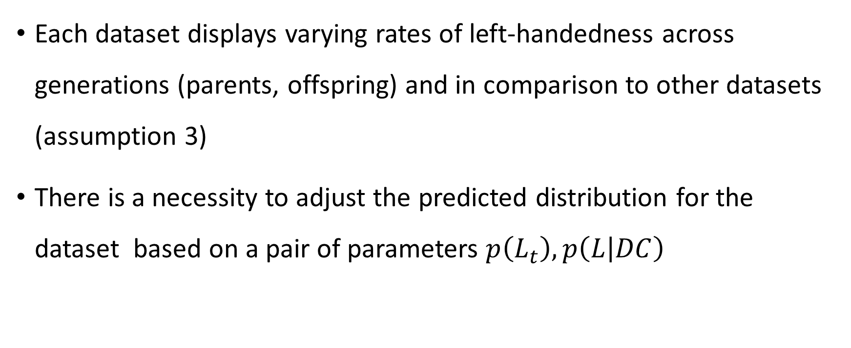
The Data
Each dataset displays varying rates of left-handedness across generations (parents, offspring) and in comparison to other datasets (assumption 3)
There is a necessity to adjust the predicted distribution for the dataset based on a pair of parameters $p\left(L_{t}\right), p\left(L | DC\right)$

Slide 8
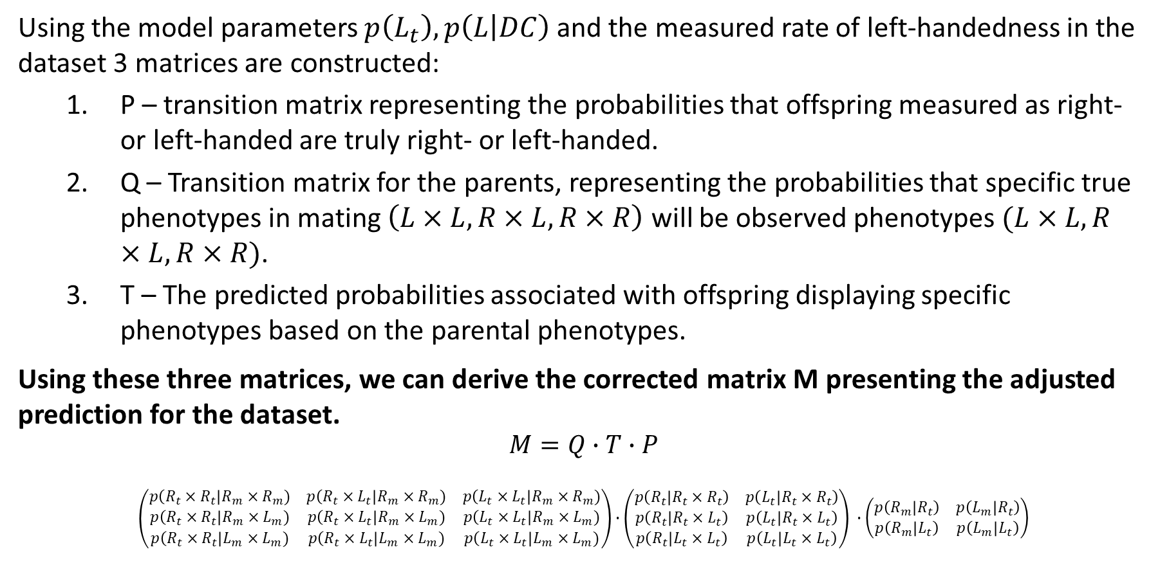
The Adjustment Process
Using the model parameters $p\left(L_{t}\right), p\left(L | DC\right)$ and the measured rate of left-handedness in the dataset 3 matrices are constructed:
P – transition matrix representing the probabilities that offspring measured as right- or left-handed are truly right- or left-handed.
Q – Transition matrix for the parents, representing the probabilities that specific true phenotypes in mating $\left(L×L,R×L,R×R\right)$ will be observed phenotypes $(L×L,R×L,R×R)$.
T – The predicted probabilities associated with offspring displaying specific phenotypes based on the parental phenotypes.
Using these three matrices, we can derive the corrected matrix M presenting the adjusted prediction for the dataset.
$$M=Q∙T∙P$$
$$\left(\begin{matrix}p\left(R_{t}×R_{t}\right|R_{m}×R_{m}) & p\left(R_{t}×L_{t}\right|R_{m}×R_{m}) & p\left(L_{t}×L_{t}\right|R_{m}×R_{m}) \\ p\left(R_{t}×R_{t}\right|R_{m}×L_{m}) & p\left(R_{t}×L_{t}\right|R_{m}×L_{m}) & p\left(L_{t}×L_{t}\right|R_{m}×L_{m}) \\ p\left(R_{t}×R_{t}\right|L_{m}×L_{m}) & p\left(R_{t}×L_{t}\right|L_{m}×L_{m}) & p\left(L_{t}×L_{t}\right|L_{m}×L_{m})\end{matrix}\right)∙\left(\begin{matrix}p\left(R_{t} | R_{t}×R_{t}\right) & p\left(L_{t} | R_{t}×R_{t}\right) \\ p\left(R_{t} | R_{t}×L_{t}\right) & p\left(L_{t} | R_{t}×L_{t}\right) \\ p\left(R_{t} | L_{t}×L_{t}\right) & p\left(L_{t} | L_{t}×L_{t}\right)\end{matrix}\right) ∙\left(\begin{matrix}p\left(R_{m} | R_{t}\right) & p\left(L_{m} | R_{t}\right) \\ p\left(R_{m} | L_{t}\right) & p\left(L_{m} | L_{t}\right)\end{matrix}\right)$$
Notes:
Q- הוא דיווח במאמר על בנייה אחרת של המטריצה, שאינה נכונה מתמטית וגם נראה שלא מתאימה לתוצאות

Slide 9
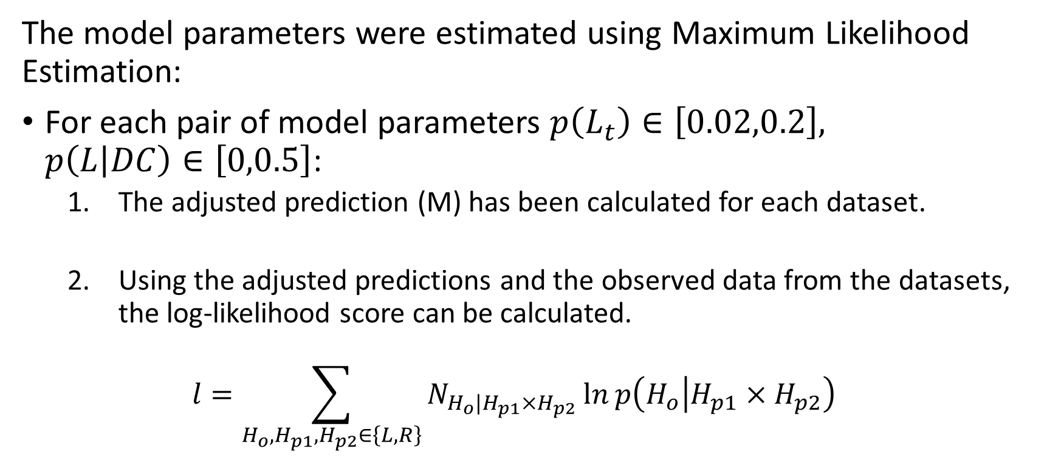
Estimating the Model Parameters
The model parameters were estimated using Maximum Likelihood Estimation:
For each pair of model parameters $p\left(L_{t}\right)∈\left[0.02,0.2\right],$ $p\left(L | DC\right)∈\left[0,0.5\right]$:
The adjusted prediction (M) has been calculated for each dataset.
Using the adjusted predictions and the observed data from the datasets, the log-likelihood score can be calculated.
$$l=\sum_{H_{o},H_{p1},H_{p2}∈\left\{L,R\right\}}{N_{H_{o}|H_{p1}×H_{p2}}\ln{p\left(H_{o} | H_{p1}×H_{p2}\right)}}$$
Notes:
לא הצהיר באופן רשמי שזה התהליך, אבל זה מה שנתן את התוצאות היחידות שמתפלגות דומה אליו

Slide 10
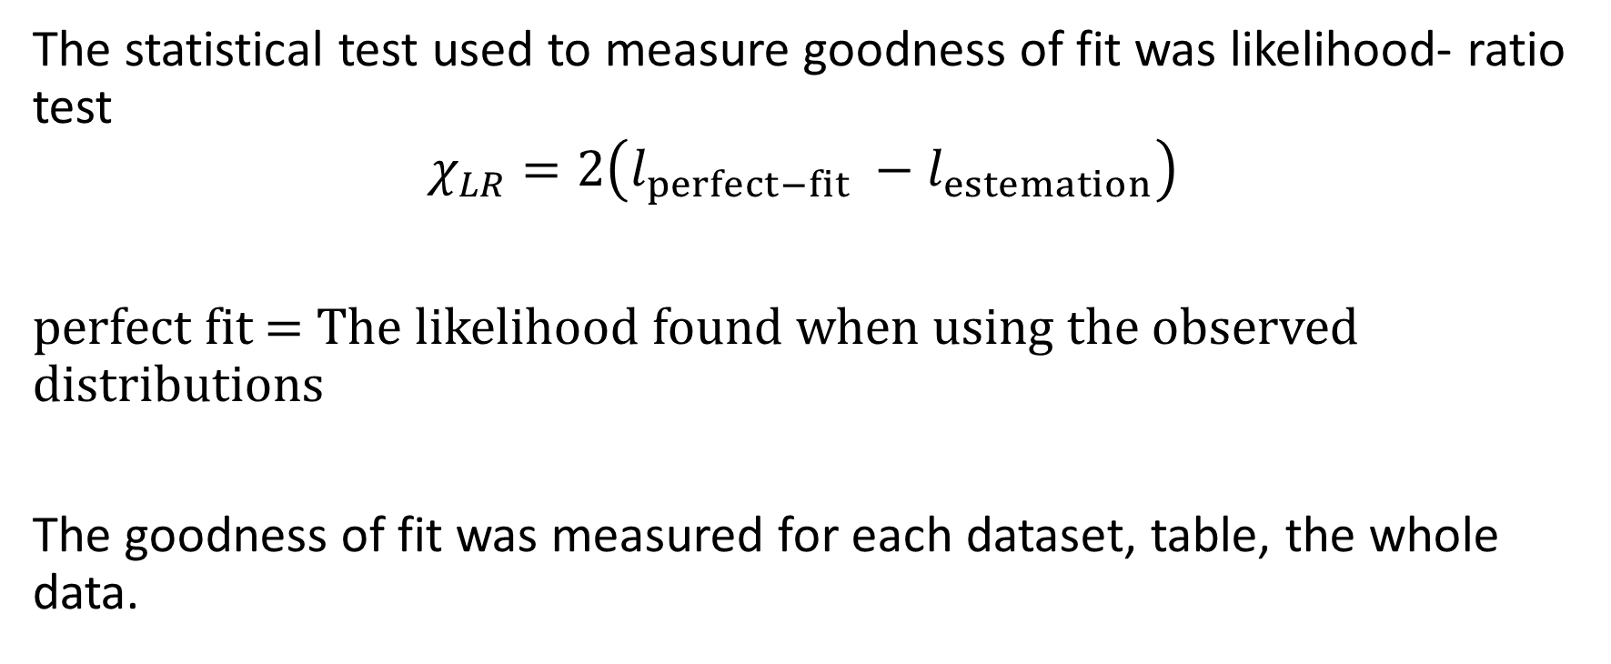
The Test Statistic
The statistical test used to measure goodness of fit was likelihood- ratio test $$χ_{LR}=2\left(l_{perfect−fit} −l_{estemation}\right)$$
perfect fit = The likelihood found when using the observed distributions
The goodness of fit was measured for each dataset, table, the whole data.
Notes:
לא הצהיר במדויק מה המבחן, נראה כמו מבחן ווילקס המטרה p>0.05

Slide 11
Results

Slide 12
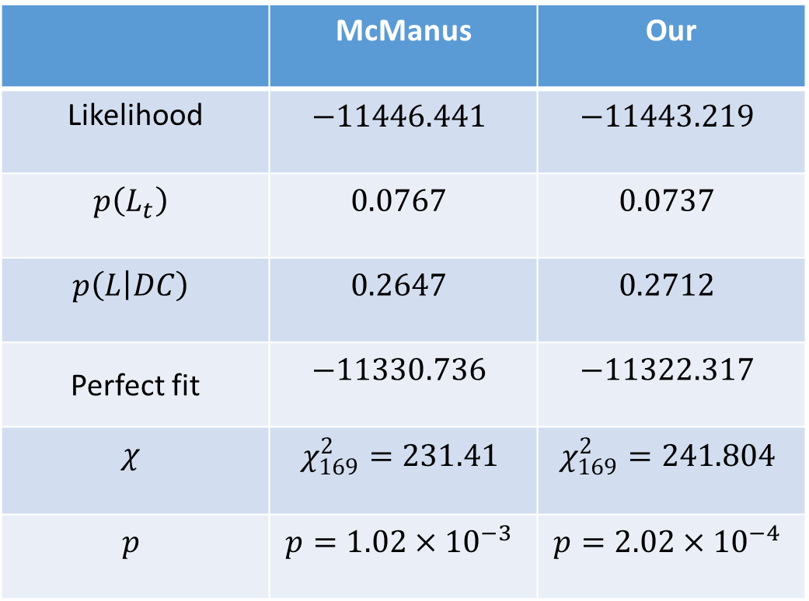
Results (using all datasets)
Our | McManus
$$−11443.219$$ | $$−11446.441$$ | Likelihood
$$0.0737$$ | $$0.0767$$ | $$p\left(L_{t}\right)$$
$$0.2712$$ | $$0.2647$$ | $$p\left(L | DC\right)$$
$$−11322.317$$ | $$−11330.736$$ | Perfect fit
$$χ_{169}^{2}=241.804$$ | $$χ_{169}^{2}=231.41$$ | $$χ$$
$$p=2.02×{10}^{−4}$$ | $$p=1.02×{10}^{−3}$$ | $$p$$
Notes:
יוצא p מובהק- לא טוב☹
לכן בוצע מעבר על כל טבלה בחיפוש אחר חריגים

Slide 13
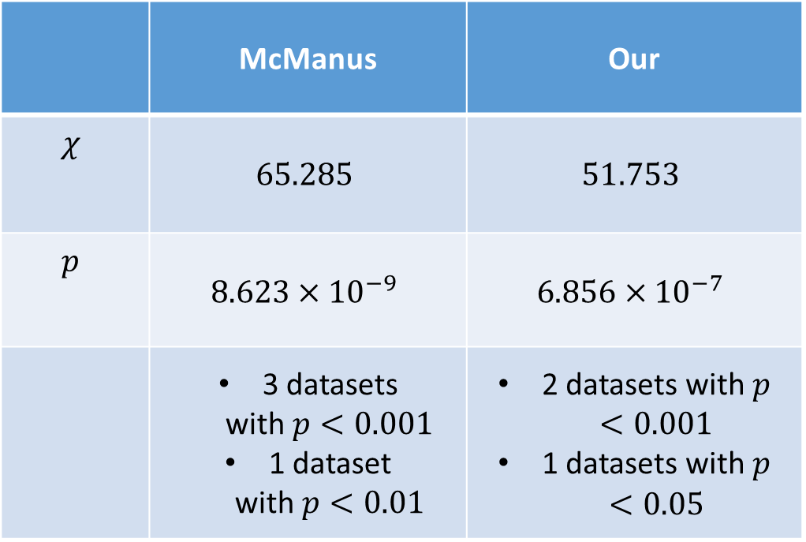
Results - triplets (1 offspring + parents)
$$results for p(L_t )=0.0775, p(L│DC)=0.25$$
Study | McManus | Our
Ramaley 1913 | 18.725*** | ***18.897
Chamberlain 1928 | 1.666 | 1.709
Rife 1940 | 3.042 | 3.142
Merrell 1975 | ***14.266 | *4.333
Annett 1973 | 0.792 | 0.77
Ferronato et al. 1947 | 1.285 | 1.253
Mascie-Taylor (unpub) | 0.109 | 0.109
Chaurasia & Goswami (unpub) | **7.498 | 3.745
Annett 1978 | 2.855 | 2.855
Carter-Saltzmann 1980 | 0.399 | 0.36
Coren & Porac 1980 | 0.931 | 1.093
McGee & Cozad 1980 | ***13.718 | ***13.487
Our | McManus
$$51.753$$ | $$65.285$$ | $$χ$$
$$6.856×{10}^{−7}$$ | $$8.623×{10}^{−9}$$ | $$p$$
2 datasets with $p<0.001$ 1 datasets with$p<0.05$ | 3 datasets with$p<0.001$ 1 dataset with$p<0.01$
$$∗ p <0.05, ∗∗ p < 0.01, ∗∗∗ p < 0.001$$
Notes:
הבדל בהתאמה נובע ככל הנראה מMerrell ו Chaurasia & Goswami
Merrell – נראה כמו שגיאת הקלדה
Chaurasia & Groswani נובע מהחישוב של שכיחות שמאליות הורים

Slide 14
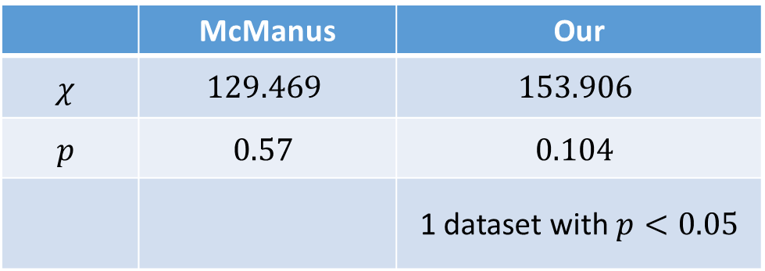
Results- multi-offspring (siblings + parents)
$$results for p\left(L_{t}\right)=0.0775, p\left(L | DC\right)=0.25$$
Study | df | McManus | Our
ICM1 | 44 | 40.219 | 40.161
ICM2 | 27 | 37.787 | 37.665
ICM2 mat | 28 | 24.962 | *47.579
ICM2 pat | 34 | 26.501 | 28.501
Our | McManus
$$153.906$$ | $$129.469$$ | $$χ$$
$$0.104$$ | $$0.57$$ | $$p$$
1 dataset with$p<0.05$
*$p <0.05$

Slide 15
Results- twins
$$results for p\left(L_{t}\right)=0.0775, p\left(L | DC\right)=0.25$$
Study (MZ) | McManus | Our
Wilson & Jones | 0.771 | 0.769
Stocks | 0.004 | 0.003
Newman et al. | 0.225 | 0.223
Bouterwek | 1.124 | 1.122
Rife | 0.062 | 0.061
Thyss | 1.634 | 1.634
Rife | 3.68 | 3.749
Dechaume | 0.079 | 0.079
Zazzo | 0.088 | 0.087
Carter-Saltzmann et al. | 0.237 | 0.235
Loehlin & Nichols | *4.408 | *4.402
Springer & Searleman | 0.006 | 0.004
NCDS | 0.183 | 0.184
Study (DZ) | McManus | Our
Wilson & Jones | 0.164 | 0.166
Stocks | 0.037 | 0.037
Newman et al. | 2.4 | 2.399
Bouterwek | 3.205 | 3.203
Rife | 0.804 | 0.804
Thyss | 0.432 | 0.43
Rife | 2.284 | 2.281
Dechaume | 0.283 | 0.281
Zazzo | *5.726 | *5.720
Carter-Saltzmann et al. | 0.099 | 0.098
Loehlin & Nichols | *5.917 | *5.917
Springer & Searleman | 1.998 | 1.997
NCDS | 1.181 | 1.182
*$p <0.05$

Slide 16
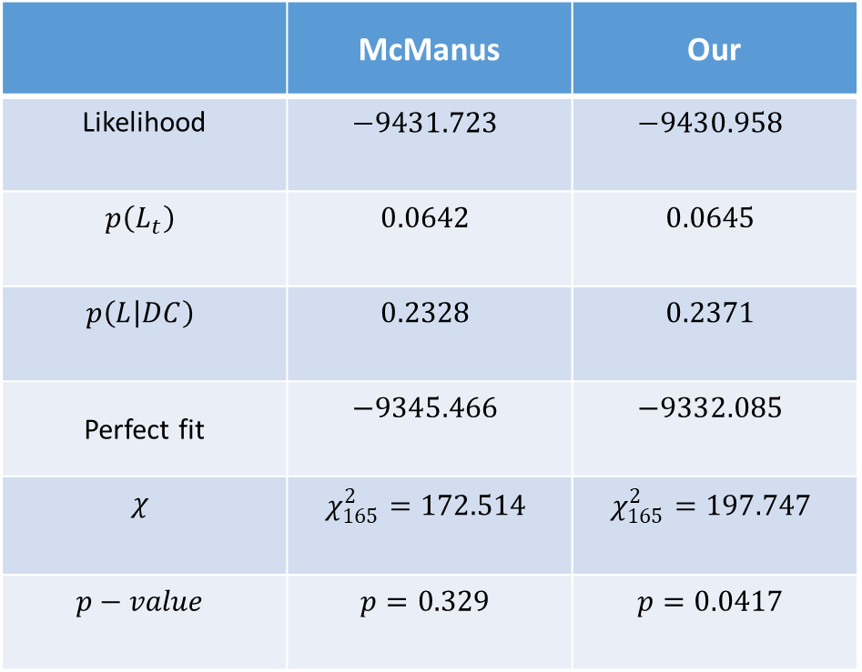
Results – reduced data (removed 4 datasets)
Our | McManus
$$−9430.958$$ | $$−9431.723$$ | Likelihood
$$0.0645$$ | $$0.0642$$ | $$p\left(L_{t}\right)$$
$$0.2371$$ | $$0.2328$$ | $$p\left(L | DC\right)$$
$$−9332.085$$ | $$−9345.466$$ | Perfect fit
$$χ_{165}^{2}=197.747$$ | $$χ_{165}^{2}=172.514$$ | $$χ$$
$$p=0.0417$$ | $$p=0.329$$ | $$p−value$$

Slide 17
Where are the differences between us and McManus(1985)?

Slide 18
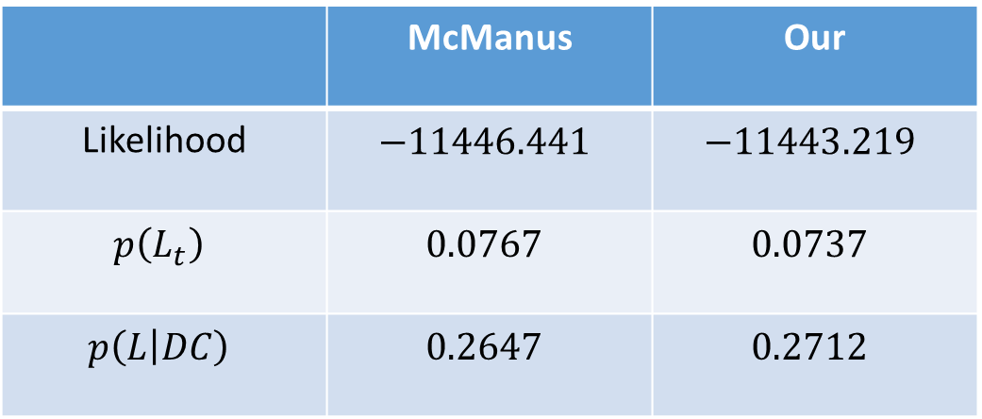
Log-likelihood & Model parameters
When using the complete data, there is a difference between the maximum likelihood found, and the estimation of the model parameters.
Our | McManus
$$−11443.219$$ | $$−11446.441$$ | Likelihood
$$0.0737$$ | $$0.0767$$ | $$p\left(L_{t}\right)$$
$$0.2712$$ | $$0.2647$$ | $$p\left(L | DC\right)$$

Slide 19
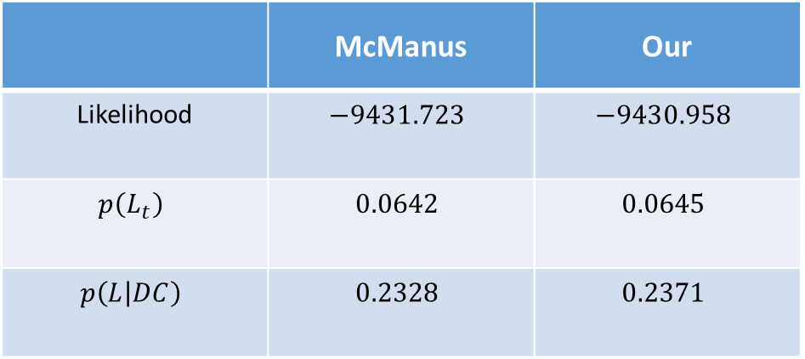
Log-likelihood & Model parameters
When using the reduced data, the difference is reduced:
Our | McManus
$$−9430.958$$ | $$−9431.723$$ | Likelihood
$$0.0645$$ | $$0.0642$$ | $$p\left(L_{t}\right)$$
$$0.2371$$ | $$0.2328$$ | $$p\left(L | DC\right)$$

Slide 20
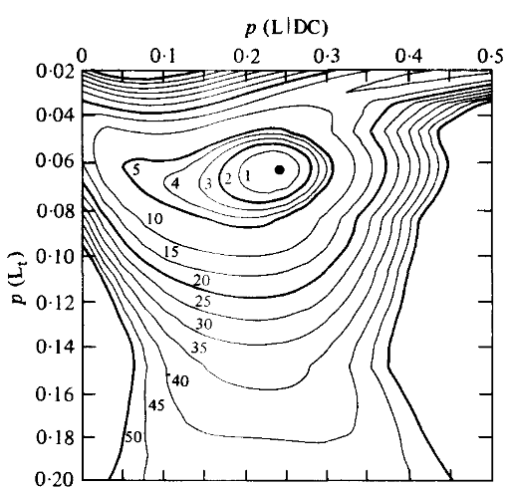
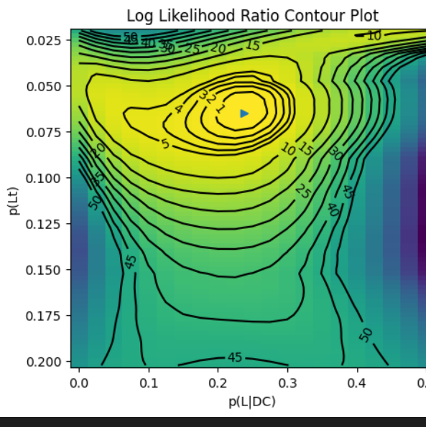
Log-likelihood & Model parameters
When using the reduced data, the difference is reduced :

Slide 21
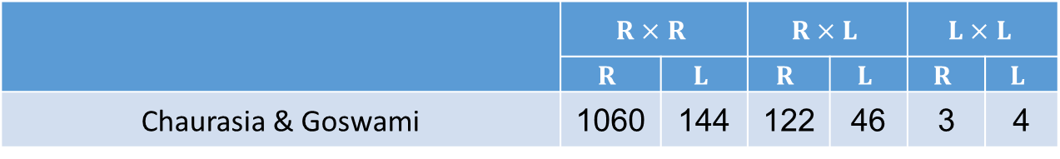
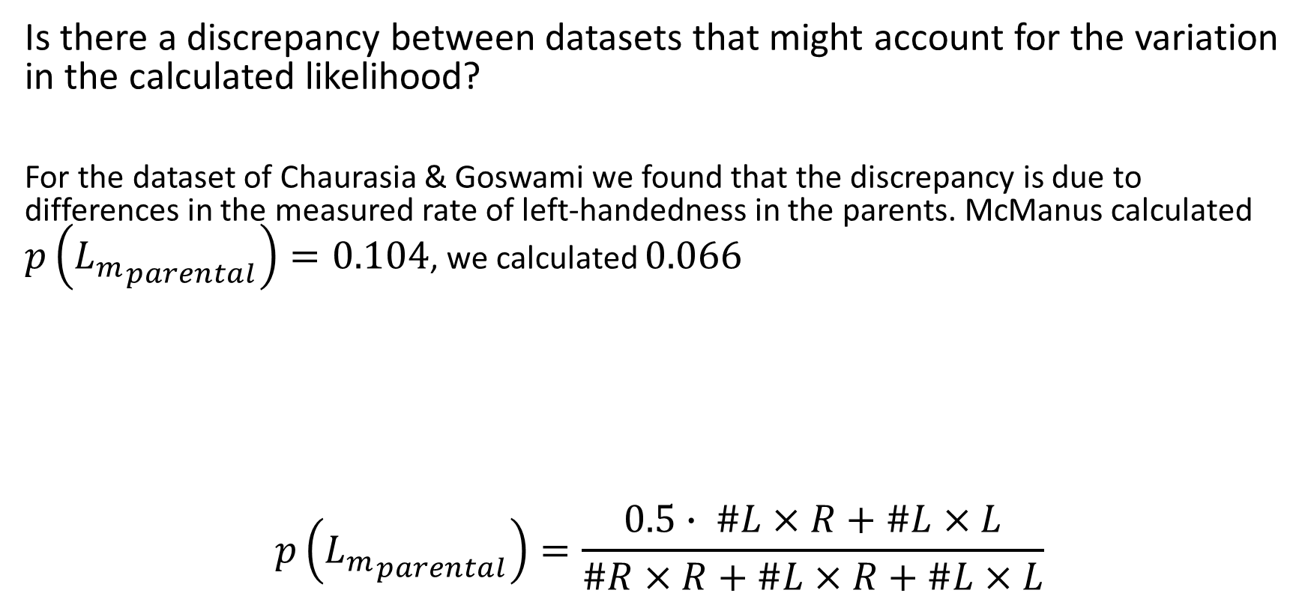
Log-likelihood & Model parameters
Is there a discrepancy between datasets that might account for the variation in the calculated likelihood?
For the dataset of Chaurasia & Goswami we found that the discrepancy is due to differences in the measured rate of left-handedness in the parents. McManus calculated $p\left({L_{m}}_{parental}\right)=0.104$, we calculated $0.066$
$$p\left({L_{m}}_{parental}\right)=\frac{0.5∙ \#L×R+\#L×L}{\#R×R+\#L×R+\#L×L}$$
 | $$R×R$$ | L|RR | $$R×L$$ | L|RL | $$L×L$$ | L|LL
 | $$R$$ | $$L$$ | $$R$$ | $$L$$ | $$R$$ | $$L$$
Chaurasia & Goswami | 1060 | 144 | 122 | 46 | 3 | 4

Slide 22
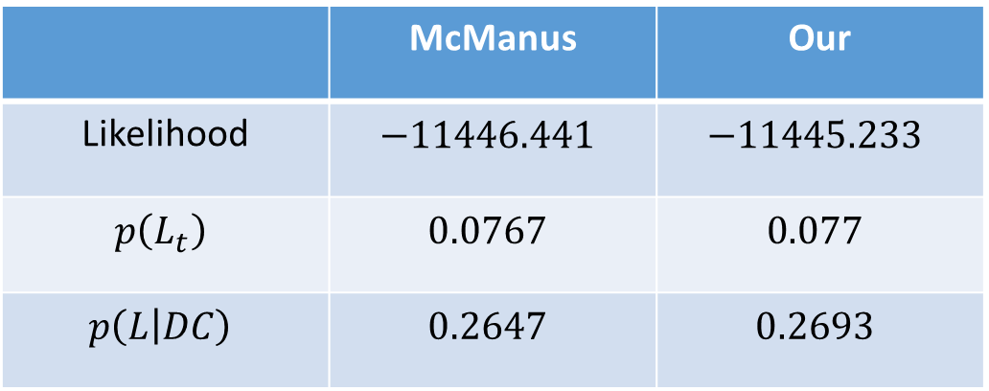
Log-likelihood & Model parameters
We repeated the MLE process for the complete data using the rate reported in McManus(1985).
Our | McManus
$$−11445.233$$ | $$−11446.441$$ | Likelihood
$$0.077$$ | $$0.0767$$ | $$p\left(L_{t}\right)$$
$$0.2693$$ | $$0.2647$$ | $$p\left(L | DC\right)$$
Notes:
נראה כי השינוי סוגר את ההפרש בכל הנוגע לפרמטרי המודל, והנראות
השאר יכול להיות שגיאות נומריות?

Slide 23
Test statistic
For 26 out of 29 datasets the test statistics are practically equal, and the differences can stem from different numerical precision.
For three datasets there is a major difference between McManus’ report and our calculation.
Study | McManus | Our
ICM2 mat | $$24.962$$ | $$47.579$$
Merrell 1975 | $$14.266$$ | $$4.333$$
Chaurasia & Goswami | $$7.498$$ | $$3.745$$

Slide 24
Test statistic – why?
We are using different test?
We calculated ‘perfect fit’ differently?
Errors in his calculations?
Notes:
מקמנוס לא נקב בשם המבחן אלא, בדרך ביצועו
ההגדרה לא ברורה
לשני ההסברים הנ"ל יש סתירה עם ההצלחה להגיע לתוצאות זהות/ כמעט זהות בתאומים, ובחלק ממידע המשפחות

Slide 25
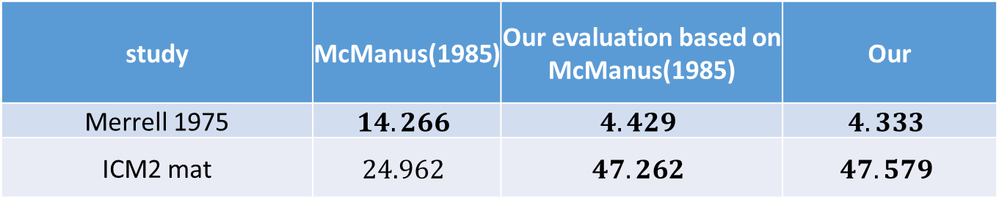
McManus had errors in his calculations?
For two datasets (Merrell, ICM2 maternal) we found by evaluating McManus’ adjusted predictions that the test statistics should have been very similar to ours.
study | McManus(1985) | Our evaluation based on McManus(1985) | Our
Merrell 1975 | $$14.266$$ | $$4.429$$ | $$4.333$$
ICM2 mat | $$24.962$$ | $$47.262$$ | $$47.579$$

Slide 26
McManus had errors in his calculations?
For these 2 datasets we infer that McManus came to similar results of log-likelihood as we calculated.
What about the calculation of the perfect fit?
Notes:
ההנחה היא שהנראות לשני הדטאסטים זהה למה שחישבנו בעצמנו כיוון שהתחזית של מקמנוס קרובות לתחזית שלנו אך לא זהות- ולכן התחזיות שלנו אמורות להיות דומות
אם כן, ההבדל הוא בחישוב סטטיסטי המבחן

Slide 27
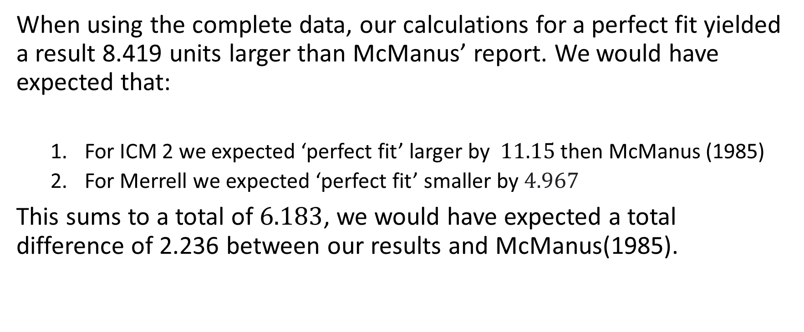
Evidence:
When using the complete data, our calculations for a perfect fit yielded a result 8.419 units larger than McManus’ report. We would have expected that:
For ICM 2 we expected ‘perfect fit’ larger by $11.15$ then McManus (1985)
For Merrell we expected ‘perfect fit’ smaller by $4.967$
This sums to a total of $6.183$, we would have expected a total difference of 2.236 between our results and McManus(1985).
Notes:
ICM2 paternal יצא גם אם הפרש גדול בין החישובים שלנו ושל מקמנוס (התוצאה הצפויה- סטטיסטי גדול ב5)

Slide 28
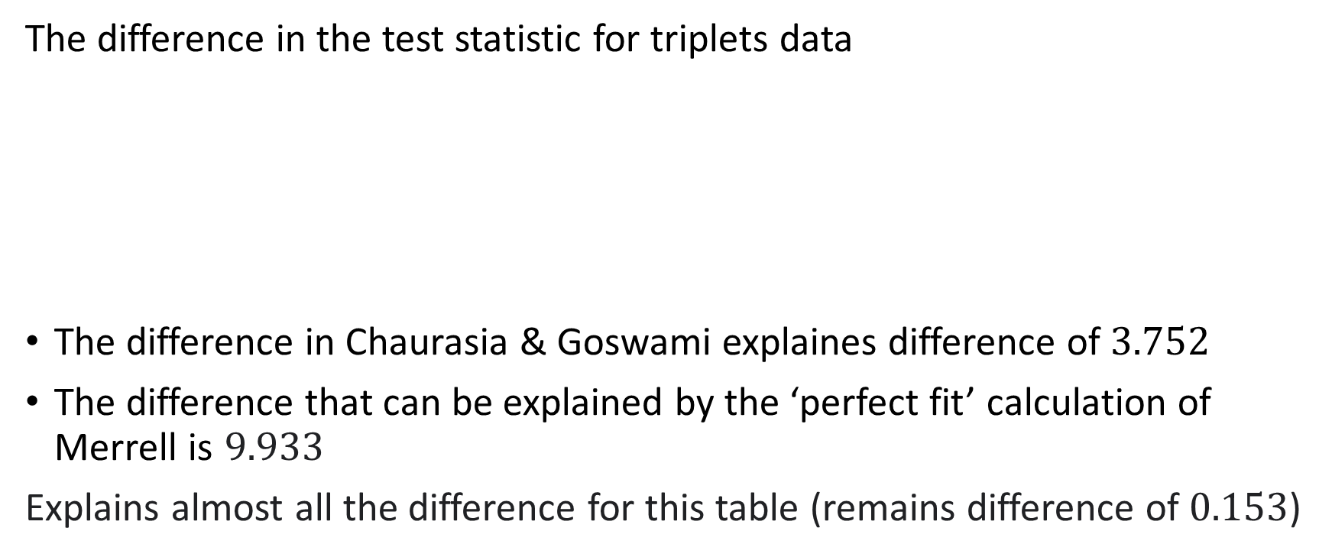
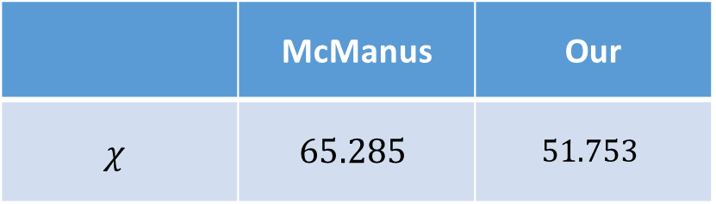
Evidence:
The difference in the test statistic for triplets data
The difference in Chaurasia & Goswami explaines difference of $3.752$
The difference that can be explained by the ‘perfect fit’ calculation of Merrell is $9.933$
Explains almost all the difference for this table (remains difference of $0.153$)
Our | McManus
$$51.753$$ | $$65.285$$ | $$χ$$
Notes:
לא הצהיר על חישובי הperect fit עבור הטבלה לכן נאלצנו לשערך.
אחרי שהוציא את 4 הדטאסטים ההפרש בסטטיסטי הוא בערך 0.3

Slide 29
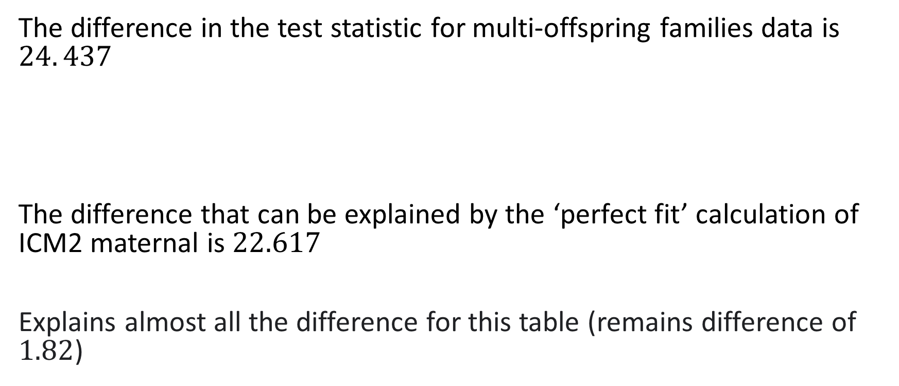
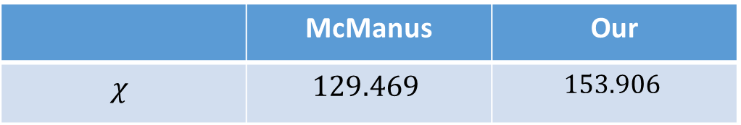
Evidence:
The difference in the test statistic for multi-offspring families data is $24. 437$
The difference that can be explained by the ‘perfect fit’ calculation of ICM2 maternal is $22.617$
Explains almost all the difference for this table (remains difference of $1.82$)
Our | McManus
$$153.906$$ | $$129.469$$ | $$χ$$
Notes:
לא הצהיר על חישובי הperect fit עבור הטבלה לכן נאלצנו לשערך.
אחרי שהוציא את 4 הדטאסטים ההפרש בסטטיסטי הוא בערך 0.21

Slide 30
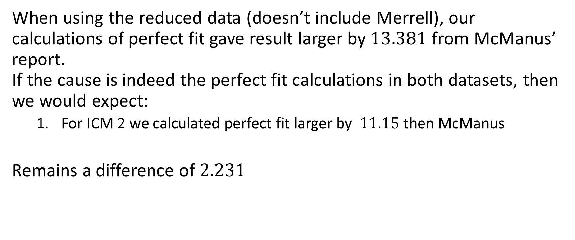
Evidence:
When using the reduced data (doesn’t include Merrell), our calculations of perfect fit gave result larger by$13.381$ from McManus’ report. If the cause is indeed the perfect fit calculations in both datasets, then we would expect:
For ICM 2 we calculated perfect fit larger by $11.15$ then McManus
Remains a difference of $2.231$

Slide 31
Implications

Slide 32
1. Outliers
McManus identified 4 outliers:
Our calculations revealed only 3 of the datasets are indeed outliers
Study | McManus | Our
Ramaley 1913 | 18.725 | 18.897
Merrell 1975 | 14.266 | 4.333
Chaurasia & Goswami (unpub) | 7.498 | 3.745
McGee & Cozad 1980 | 13.718 | 13.487

Slide 33

2. Overall fit
If there was miscalculation of the ‘perfect fit’ than the results reported by McManus should have been:
When removing all 4 : $χ^{2}=194.814$,$p=0.056$.
When removing only 3: $χ^{2}=198.559$,$p=0.0$43.

Slide 34
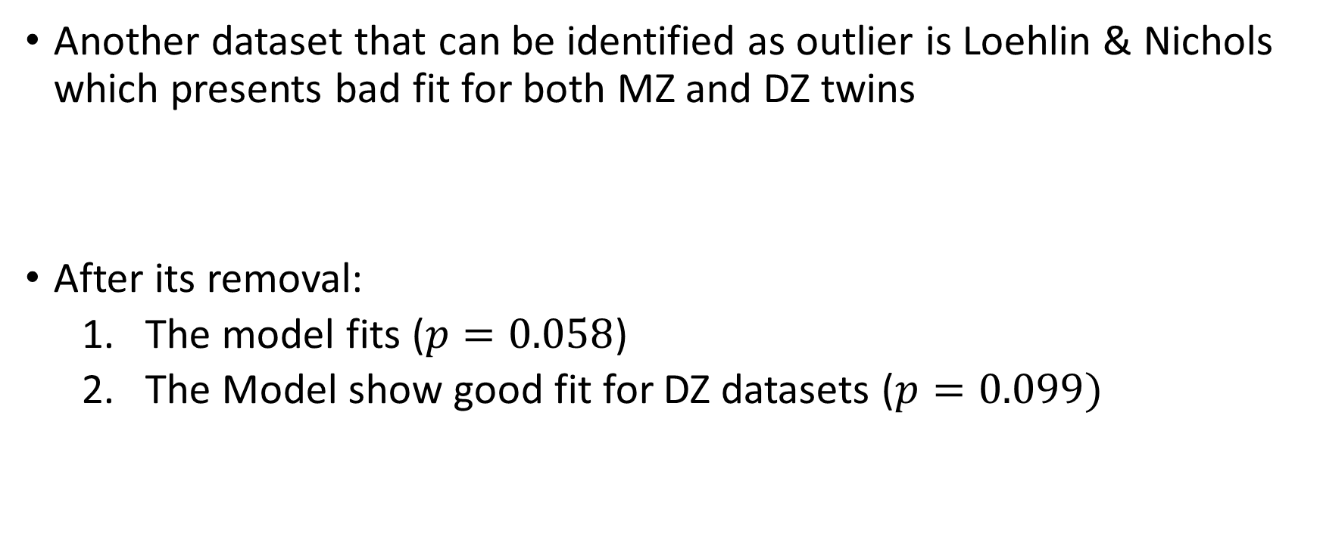
2. Overall fit
Another dataset that can be identified as outlier is Loehlin & Nichols which presents bad fit for both MZ and DZ twins
After its removal:
The model fits ($p=0.058$)
The Model show good fit for DZ datasets ($p=0.099)$
Study (MZ) | McManus | Our
Loehlin & Nichols | 4.408 | 4.402
Study (DZ) | McManus | Our
Loehlin & Nichols | 5.917 | 5.917

Slide 35
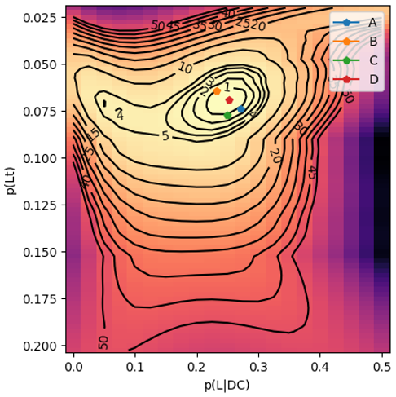
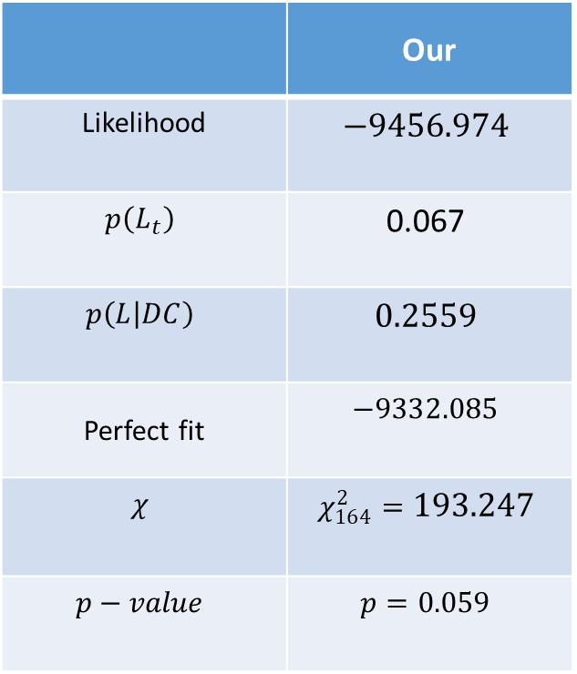
2. Overall fit (using our reduced data)
Our
$$−9456.974$$ | Likelihood
$$\text{0}\text{.}\text{067}$$ | $$p\left(L_{t}\right)$$
$$0.2559$$ | $$p\left(L | DC\right)$$
$$−9332.085$$ | Perfect fit
$$χ_{164}^{2}=193.247$$ | $$χ$$
$$p=0.059$$ | $$p−value$$
Notes:
ההתאמה של המודל של מקמנוס $p=0.046$

Slide 36
Conclusions

Slide 37
Conclusions
For 26 out of 29 datasets, we calculated similar expected values and received similar test statistic.
For 2 datasets, the expected values are similar but the test statistic is different.
For the remaining dataset, the differences seem to stem from miscalculation of the expected values
These differences cause to the acceptance of the model by McManus(1985), but the rejection of the model by our analysis.

